Slide 1

ONLINE INDIAN GROCERY STORE MANAGEMENT SYSTEM
DONE BY:
KOTTE DEEKSHITHA
PAVAN BHARADWAJ ANNAMBHOTLA

Slide 2
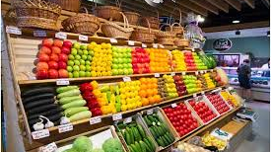
PROJECT OVERVIEW
Objective: Develop an Online platform for managing grocery store operations such as inventory, order management , customer interactions and payment processing
Key Features:
Product catalog and Inventory management
Customer registration and Profile management
Order Placement and Tracking
Payment integration
Admin dashboard for analytics

Slide 3
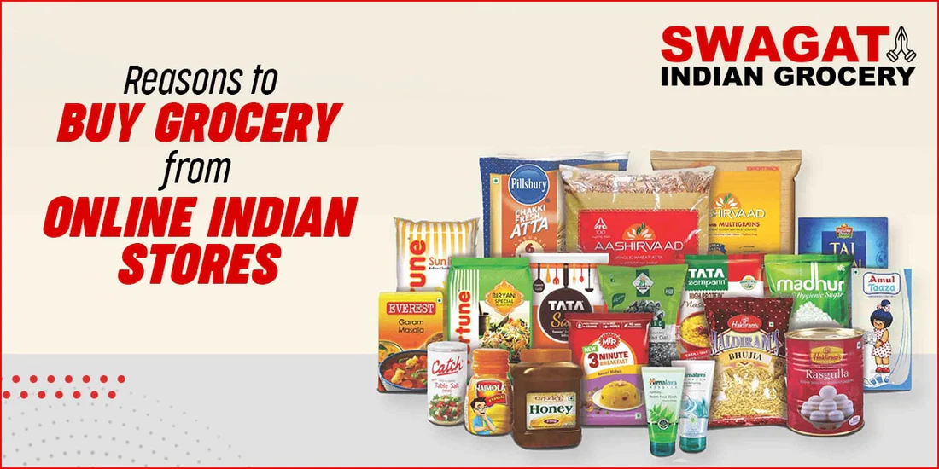
Problem statement
Current Challenges in grocery retail:
Limited accessibility
Lack of real-time inventory updates
Difficulty in managing large volumes of orders manually
Poor customer engagement
Solution: The Solution for the above challenges is an integrated online platform to streamline and automate the operations of store while providing customers a convenient and easy shopping experience

Slide 4
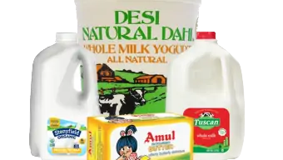
Project goals
Primary Goal:
Build a scalable and user-friendly online grocery store management system.
Specific Goals:
Automate inventory management
Create an easy-to-use interface for customers
Enable seamless order management(from car to delivery)
Integrate secure payment gateway
Develop an admin panel for managing products , orders, and customers

Slide 5

Technology stack
Frontend: HTML/CSS , Bootstrap, React.js (UI/UX)
Backend: PHP (for server-side logic)
Database: MySQL (scalable and flexible)
Payment Integration: API
Authentication : Wen Tokens for authentication and authorization

Slide 6
PROJECT timeline
Week 1: Research and Planning
Finalize the Project requirements
Define system architecture
Select technologies to be used
Week 2-3: Database Design and Frontend development
Build a basic frontend design (Login,SignUp,Home)
Build an initial database schema
Week 3: Backend Development Phase
Develop Key features : Product Catalog , Order management, Customer registration setup
Implement Admin Dashboard for product and order management
Week 4: Testing and Updating
Manually checking the project with different inputs
Updating the project with needful changes

Slide 7
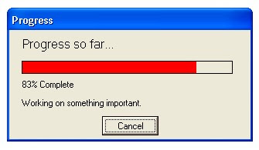
Progress so far
Completed tasks:
Finalized Project requirements and features
Designed database schema and developed initial model
Created basic frontend model
Developed user registration and login system
In Progress:
Backend core development for the project
Order placement and management system
Admin dashboard development
Payment gateway

Slide 8
Individual contributions
Member 1 (Deekshitha):
Responsible for frontend UI design and script development
Implemented customer registration and login system (frontend)
Developed the admin dashboard for order tracking and reporting
Working on backend development
Implementing order management functionality
Helped with overall project planning and coordination
Member 2 (Pavan):
Developing the backend with PHP
Designed the MySQL database schema
Creating API for product management
Implemented customer registration and login system(backend)
Working on payment gateway , testing and debugging
Helped with overall project planning and coordination

Slide 9
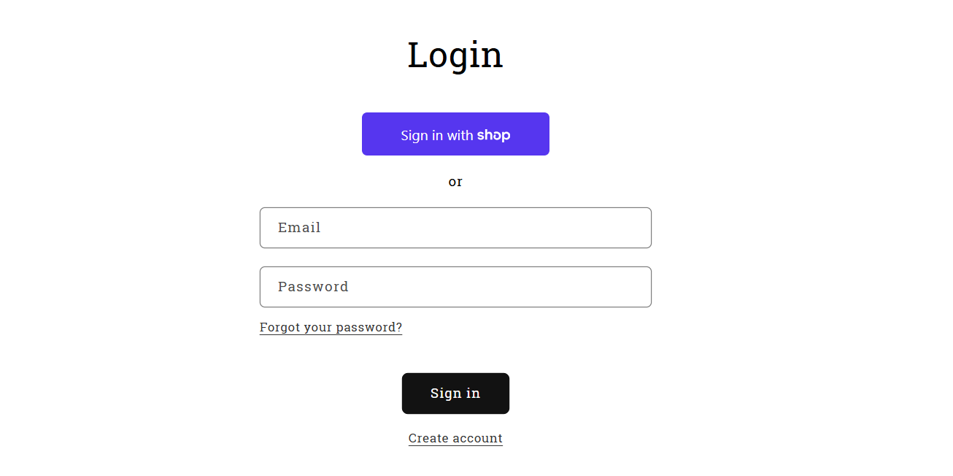
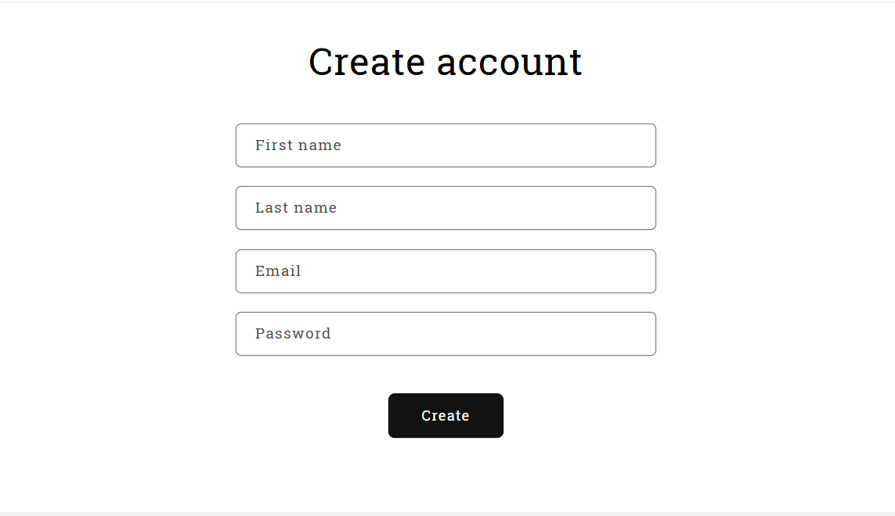
outputs
LOGIN PAGE
SIGNUP PAGE

Slide 10
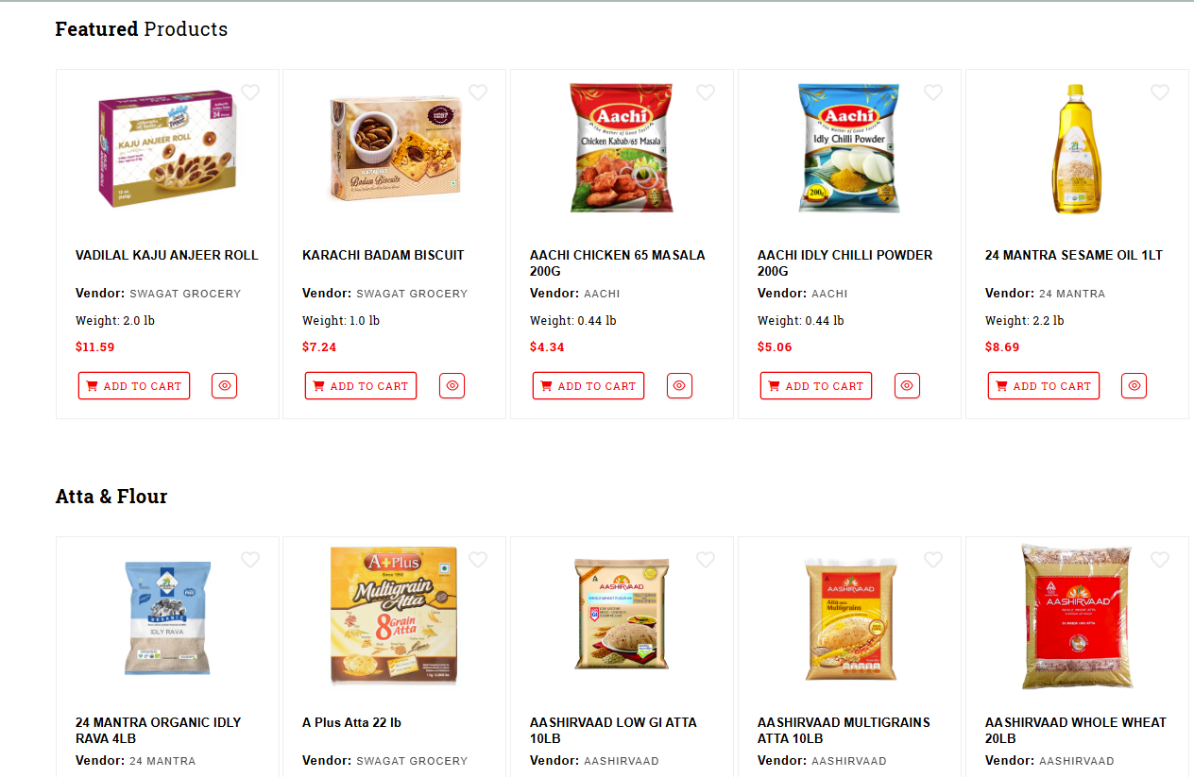
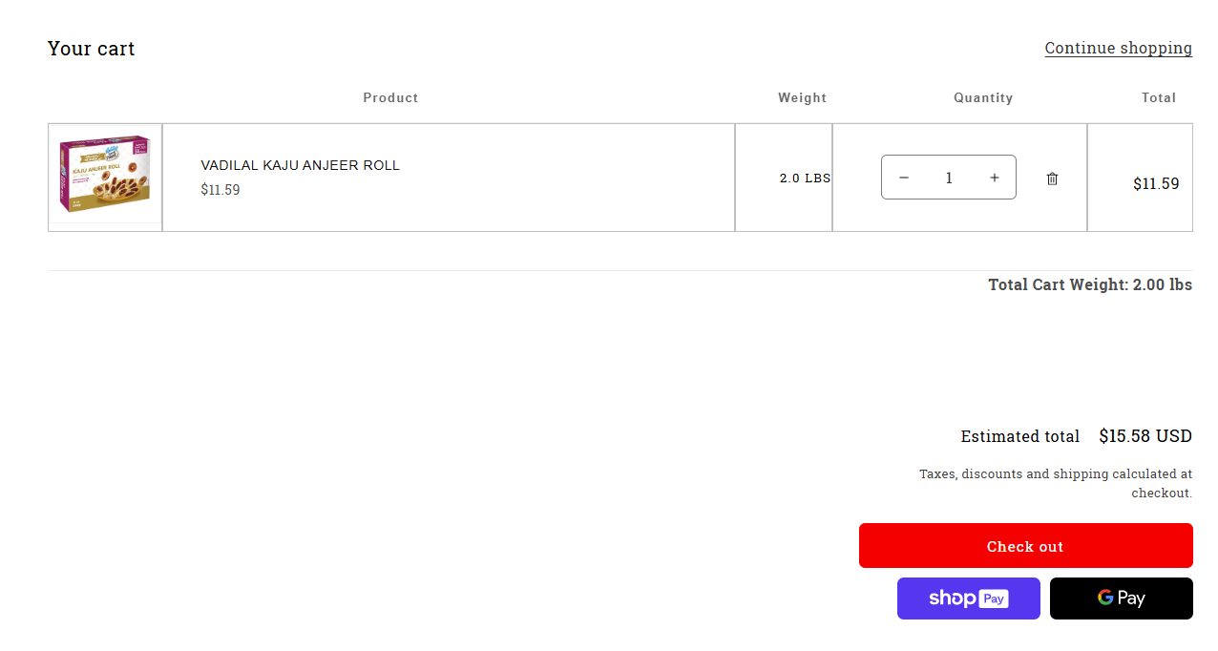
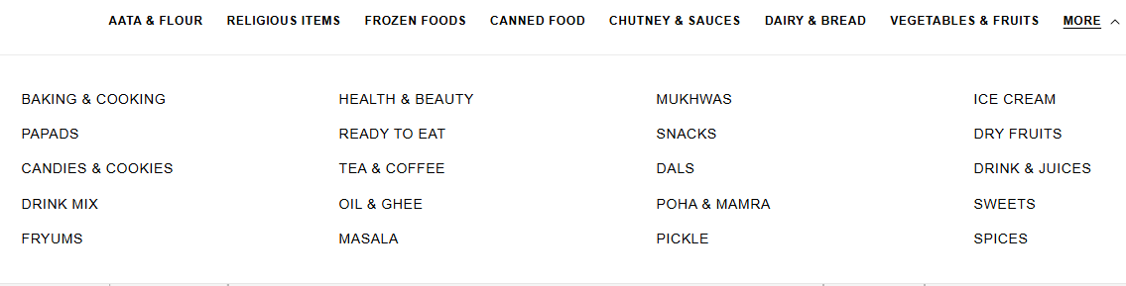
HOME PAGE
CART AND CHECKOUT PAGE
DROPDOWN MENU

Slide 11
CONCLUSION
Summary: The Online Indian grocery management system is progressing well with key features already setup . We are focusing on backend development right now and testing .
Expected Output: This platform makes grocery store operations easier for customers to shop online and for stores to manage their inventory and orders efficiently

Slide 12
Thank you !
Questions ?

